Slide 1
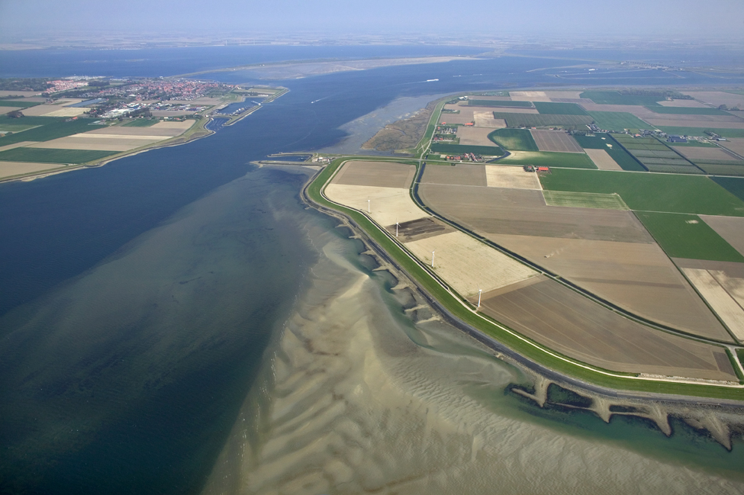


Basic Configuration Files

Slide 2
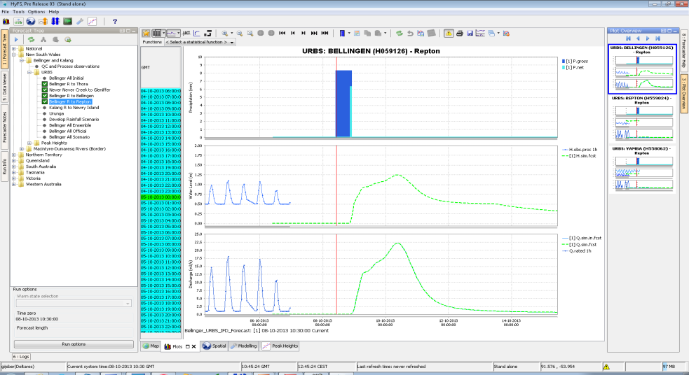
FEWS-Application versus Delft-FEWS
Software binaries
(Delft-FEWS)
Instructions
(xml/csv-configuration)
FEWS application

Slide 3
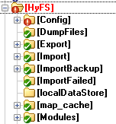
Application directory
%REGION_HOME%
What can I find in the application directory?:
Config – where the configuration/instructions are held
LocalDataStore – Database cache where your local data is held
Import/Export – for data exchange with outside world
Modules – for model execution
Map_cache

Slide 4
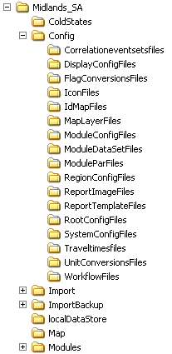
Main Configuration – SystemConfigFiles
Primary part of the configuration of DELFT-FEWS
as a system, including
Explorer
FEWS Explorer (main GUI)
Time Series Display
line style, line color, view period
ModuleDescriptors
plug-in modules available for Delft-FEWS
DisplayDescriptors
plug-in displays available for Delft-FEWS
DisplayGroups
pre-defined displays / shortcuts

Slide 5
Main Configuration – RegionConfigFiles
Basis of the specific configuration of Delft FEWS
for a particular region, including
Parameters
Locations
LocationSets
Filters
ValidationRuleSets
Thresholds
ModuleInstanceDescriptors
WorkflowDescriptors
etc.

Slide 6
Main Configuration – ModuleConfigFiles
Module Configuration:
This directory contains the “working” files
can be organised in sub-directories
Examples of module files:
Interpolation
Transformation
Import
Export
Archive
Report
General adapter

Slide 7
Main Configuration – WorkflowFiles
Workflow Files:
This directory contains the “control” files
Each workflow gives a list of modules that you want to run…

Slide 8
Main Configuration – DisplayConfigFiles
Display Configuration
This directory contains most of the files relating to the displays:
Longitudinal display
Spatial display
System monitor display
Schematic Status display

Slide 9
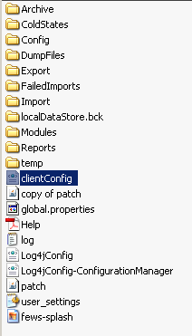
Root configuration
Differs between Stand Alone and Operator Client
Common files
clientConfig.xml – SA or OC?
global.properties – location of reference folders
Help.pdf – Help document
log.txt – Log of messages
Log4jConfig.xml – What should be logged?
(20xx0x_)patch.jar – includes bug fixes / enhancements of current bin (“update” of bin)
fews-splash.jpg – Start up picture
Additional for OC
synchChannels – synch activities
synchProfiles – different profiles for synch activities
synchConfig – location for synchronization

Slide 10
FEWS Configuration
Where is the configuration?
Primary Location (checked first): Local file system
All files available as XML config file
Naming convention described applies
Secondary Location (synchronised): database
Corresponding table for each section of configuration (e.g. Regional, System etc.)
Associated default version table to identify active version

